Slide 1
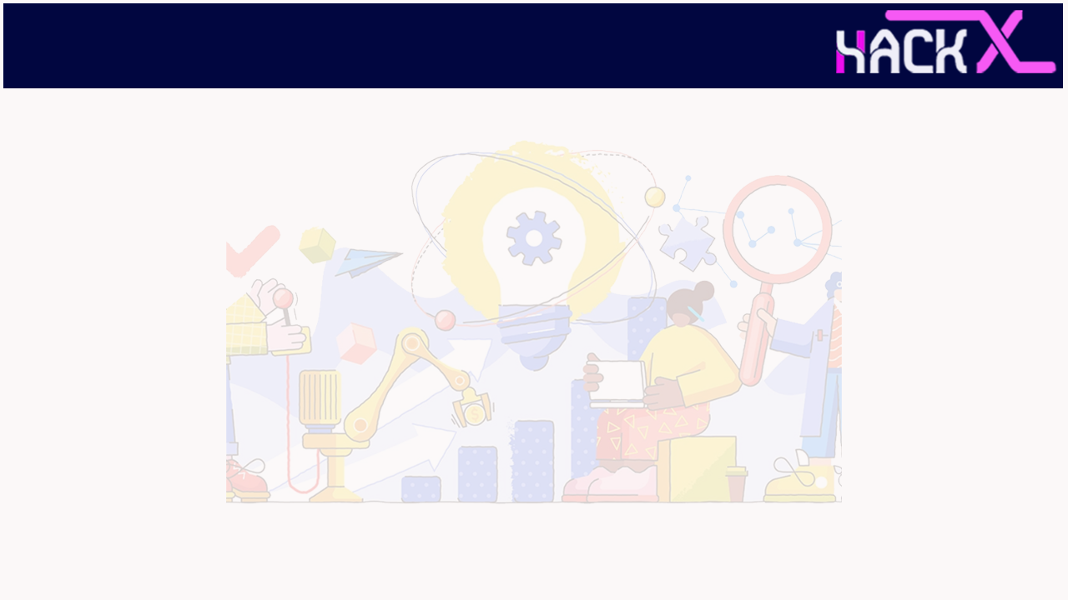
SLIDE 1
Alone
2. P.Karimulla Khan and 9587594265 (Faizan Alam )
3. Wearable tech
4. Wearable Device for Measurement and Indication of Emotional State

Slide 2
SLIDE 2
ABSTRACT
This project aims to solve the daily challenges faced by the people, who are unable to speak (dumb) or the ones who have recently undergone an accident and are temporarily unable to speak. It can also be used by elderly people, who find difficulty in speaking. With this wearable hand assistant glove, dumb people or patients can easily communicate by just tapping the points on the glove by their thumb that results in 12 different commands that are both audible audio and image on any Android smartphone via. an application. This can also be used in automation of day to day gadgets like home appliances and many more.

Slide 3
SLIDE 3
NOVELTY
The project is unique in its function as till date dumb people have been using either sign language or used to simply point at things and the other person had to guess what exactly the person wants to convey ,but using our project he can simply press buttons and convey his exact feelings with ease and the other person need not also know the sign language .
Such a product has not been in use or development and hence itself makes this project unique.
The usability of the project is not restricted to any certain area or range ,the user can easily wear it and use it wherever he feels the need of it.
This project brings ease to both sides as the user doesn't have to learn any sign language or need a person to explain others what he is saying and the listener would also understand everything easily .
The Gloves having a stylish look doesn't bother the user as an extra equipment which he or she had to carry .

Slide 4
SLIDE 4
TECHNOLOGY STACK
● Microprocessor - Arduino UNO
● Bluetooth Module - HC-05
● Programming Language - C
● IDE - Arduino IDE
● App - MIT App Inventor

Slide 5
SLIDE 5
HARDWARE / SOFTWARE IMPLEMENTATION
This project consists of an Arduino UNO for processing. And HC-05 bluetooth module to send the data in an Android application. Tapping the points on the glove by their thumb to send the digital value to the phone.
Flow Diagram : https://faizan-alam-1.github.io/Flow/

Slide 6
SLIDE 6
BUSINESS SCOPE
We intend to decrease the circuit board size to fit it it with the gloves itself and also we intend to make the gloves look more sophisticated and stylish.We see hospitalised patients ,dumb(not able to speak ) people ,and old aged people finding difficulty in speaking as our major potential customers.we do not intend to make huge profits from a single unit and would keep the price affordable and because of the ease and comfort it brings to the user the sales would automatically blow up also benefitting us - The creators .
We also have thought few advancements for the gloves but will implement it after getting a feedback from the users based upon their needs.We intend to improve the functionality of the gloves assistant. We intend to make a pair of gloves having 14 buttons on each of the glove making a complete keyboard of alphabets and space button which would enable the user to write out a custom message which would then be shown as a message on the mobile application and also so would be converted into speech output easily communicating the exact statement.

Slide 7
Video Demonstration
https://youtu.be/xp0sE6jLqvM
GitHub Link
https://github.com/Faizan-Alam-1/HackX
Some pictures of our model
https://photos.app.goo.gl/fkm15D3iiTfaNavY7

